Slide 1


Bottom-Up Intelligence Analysis
John Beverley
Assistant Professor, University at Buffalo
Co-Director, National Center for Ontological Research
Affiliate Faculty, Institute of Artificial Intelligence and Data Science

Slide 2
Outline
Confirmation Bias and Serial Position Effects
Models of Intelligence Cycle Bias
Caveats for Ontology-Based Strategies

Slide 3
Outline
Confirmation Bias and Serial Position Effects
Models of Intelligence Cycle Bias
Caveats for Ontology-Based Strategies

Slide 4
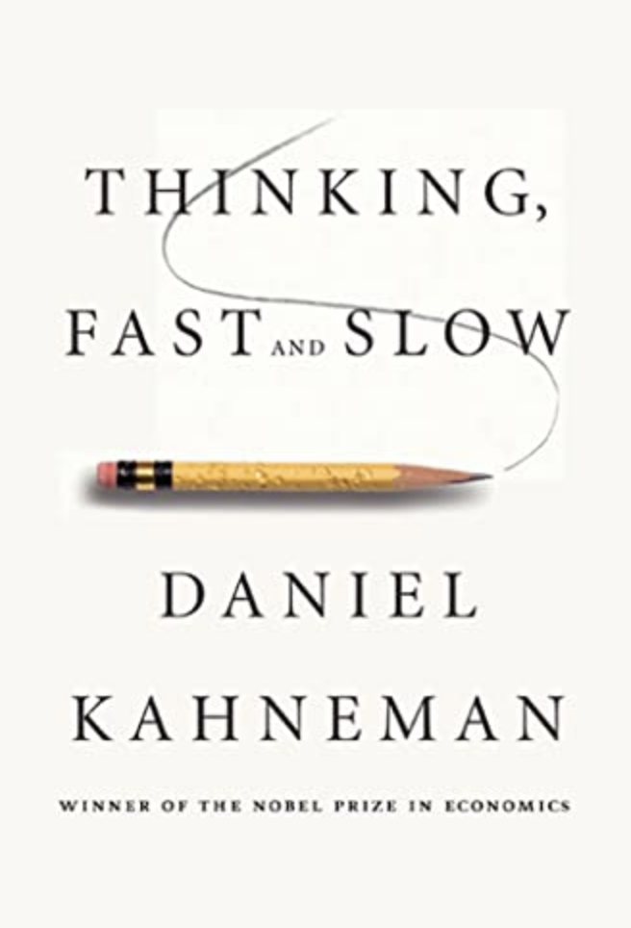
System 1 & System 2
Generally speaking, we often provide intuitive responses to problems we experience in the real world
This is true for novel problems and for analytic problems
The bat and ball puzzle is an analytic problem, requiring a precise answer with minimal room for error

Slide 5
Group Exercise
Albert and Bernard want to know Cheryl’s birthday. She gives them 10 possible dates:
May 15, May 16, May 19, June 17, June 18, July 14, July 16, August 14, August 15, and August 17
Cheryl then tells Albert the month and tells Bernard the day.
Albert: “I don't know Cheryl's birthday; I know Bernard doesn’t know.” Bernard: “At first I didn't know, but I know now.” Albert: “Now I know!”
WHEN?!

Slide 6
Group Exercise
Albert and Bernard want to know Cheryl’s birthday. She gives them 10 possible dates:
May 15, May 16, May 19, June 17, June 18, July 14, July 16, August 14, August 15, and August 17
Cheryl then tells Albert the month and tells Bernard the day.
Albert: “I don't know Cheryl's birthday; I know Bernard doesn’t know.” Bernard: At first I didn't know, but I know now.” Albert: “Now I know!”

Slide 7

Analysis of Competing Hypotheses (ACH)
Designed to avoid pitfalls of quick, intuitive, judgments with a step-by-step strategy for cultivating methodical, reflective, intelligence gathering
Specifically for guarding against confirmation bias and serial position effects

Slide 8
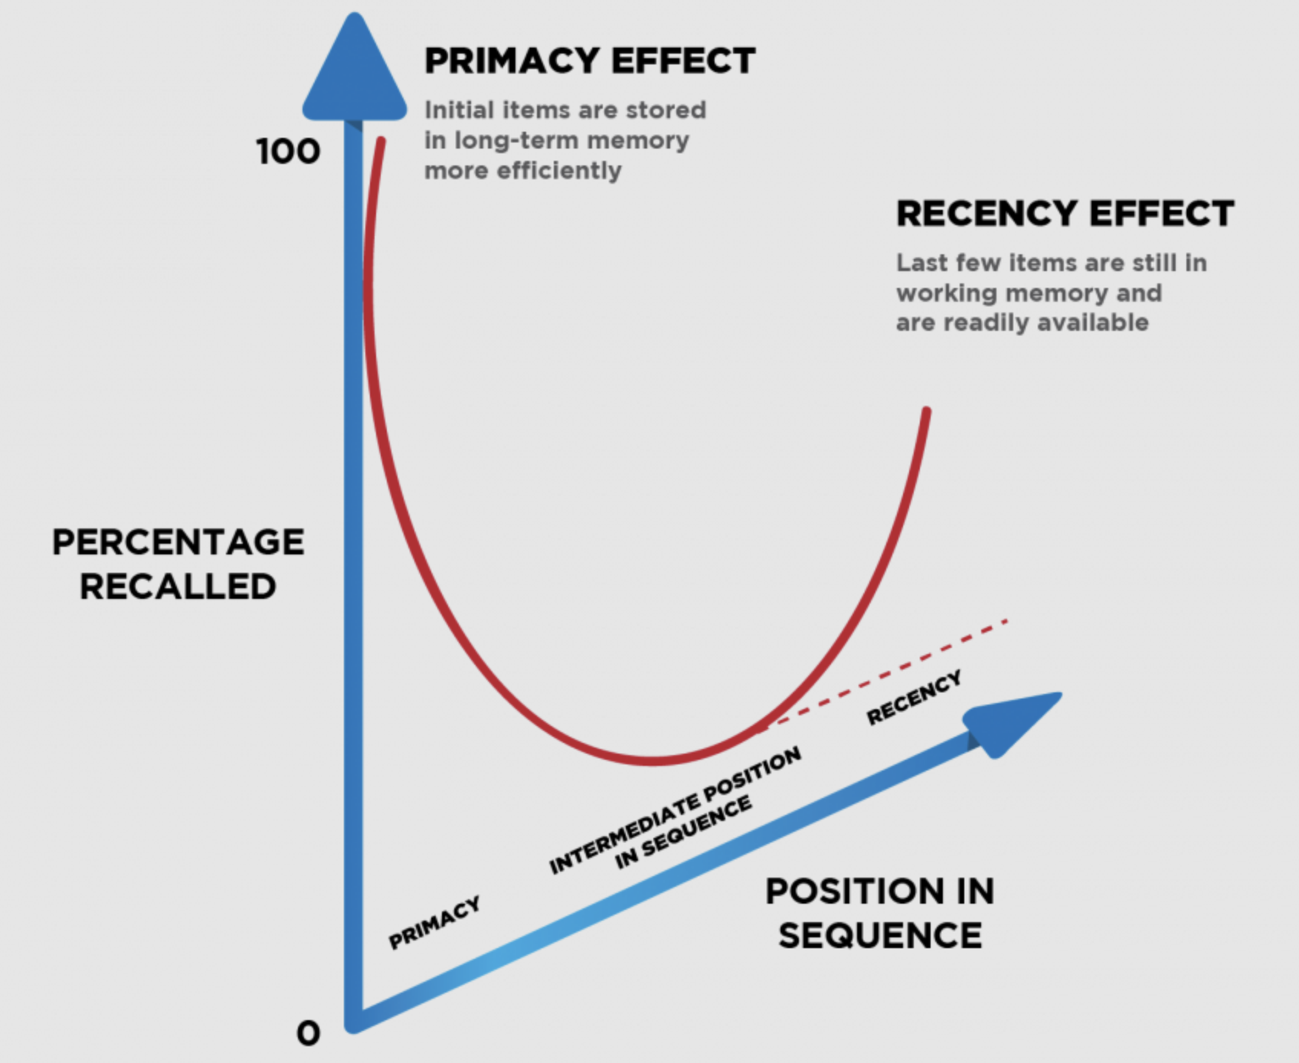
Serial Position Effects
Disposition towards recalling initial and most recent items provided in a sequence
Effect examples:
Google Page-Rank
E-Commerce
Product Reviews
Restaurant Menus
TV Cliffhangers

Slide 9
Confirmation Bias
Disposition to seek information that supports, rather than rejects, existing beliefs.
Typically involves interpreting evidence in a manner that confirms those beliefs.
Examples:
Social media feeds
Political convictions

Slide 10
Confirmation Bias
Disposition to seek information that supports, rather than rejects, existing beliefs.
Typically involves interpreting evidence in a manner that confirms those beliefs.
Examples:
Social media feeds
Political convictions

Slide 11
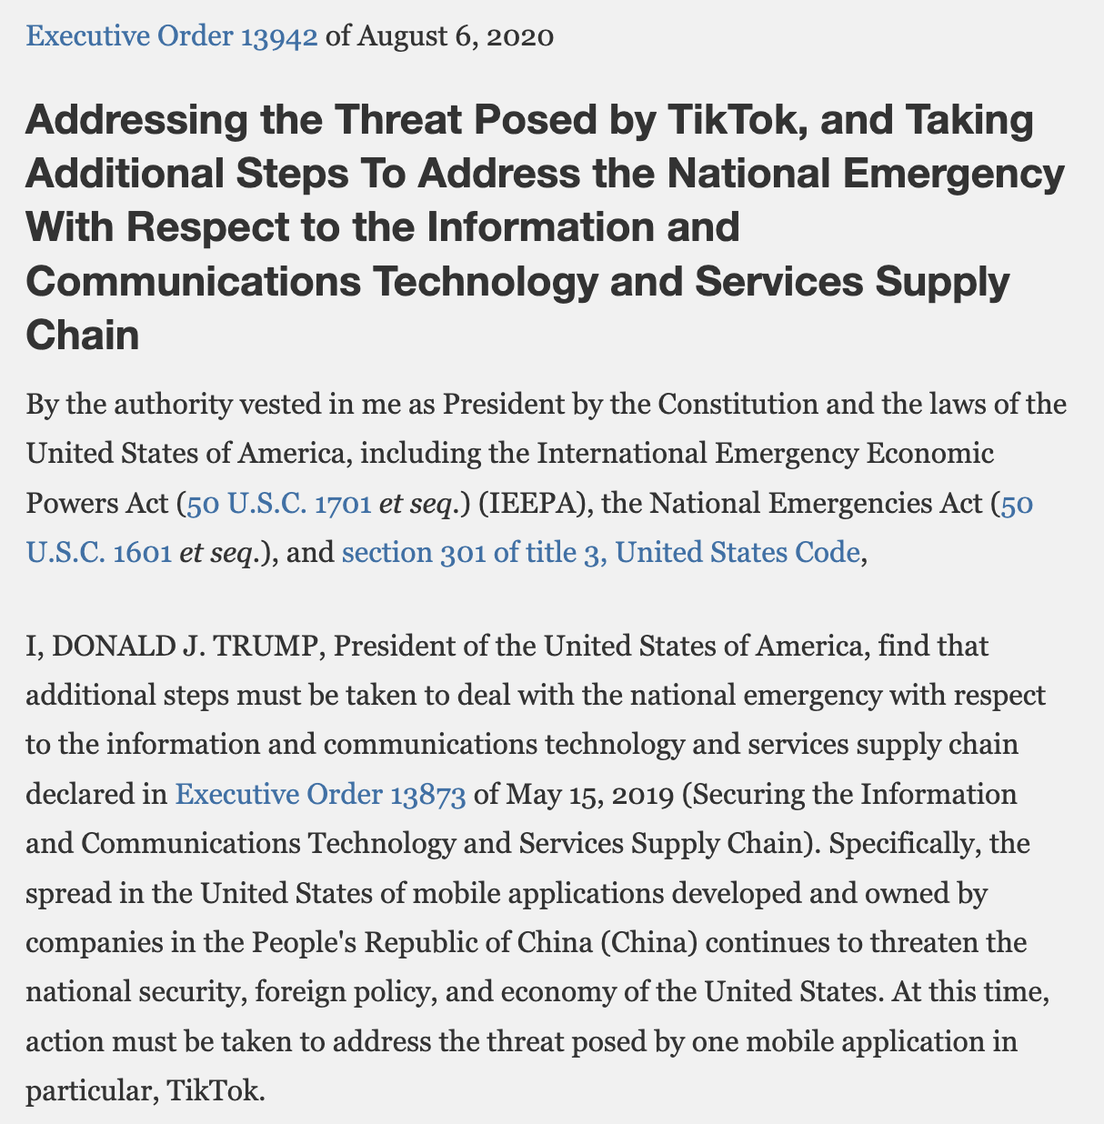
TikTok Ban
In 2020, President Donald Trump issued an executive order banning new downloads of TikTok to U.S. devices
It was alleged that TikTok was gathering data on U.S. citizens which was being shared with parent company ByteDance in Beijing

Slide 12

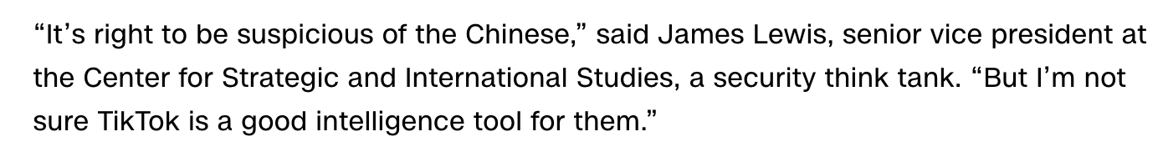
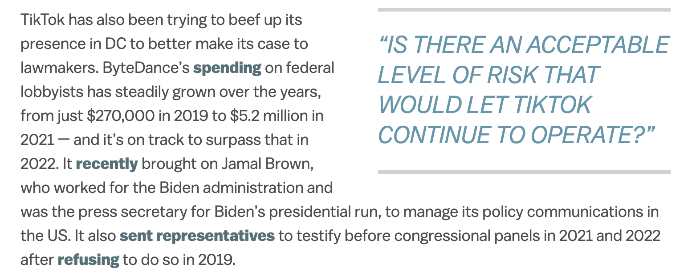
Responses to TikTok Ban

Slide 13
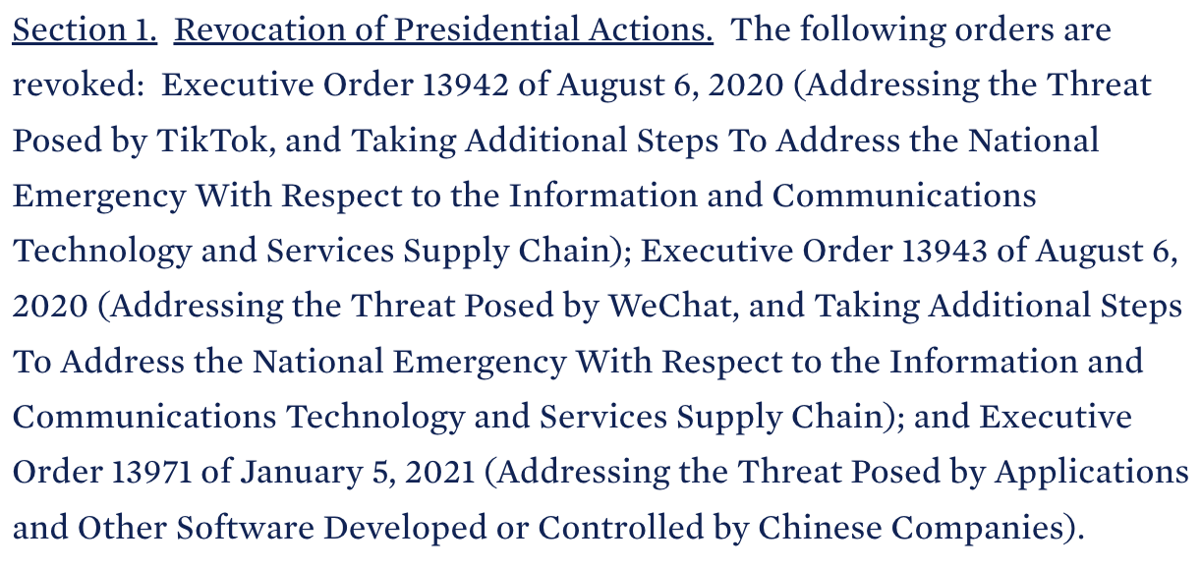
Executive Order Revoked
In 2021, President Joe Biden revoked Executive Order 13942, effectively lifting the TikTok ban
President Biden ordered a more deliberate and methodical investigation into TikTok data sharing practices

Slide 14
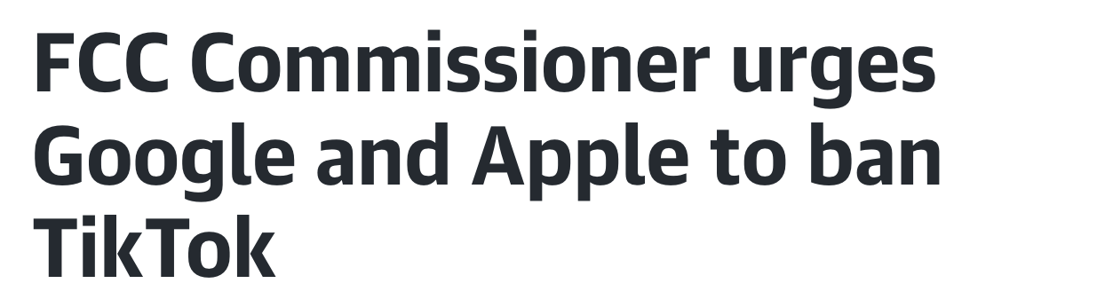

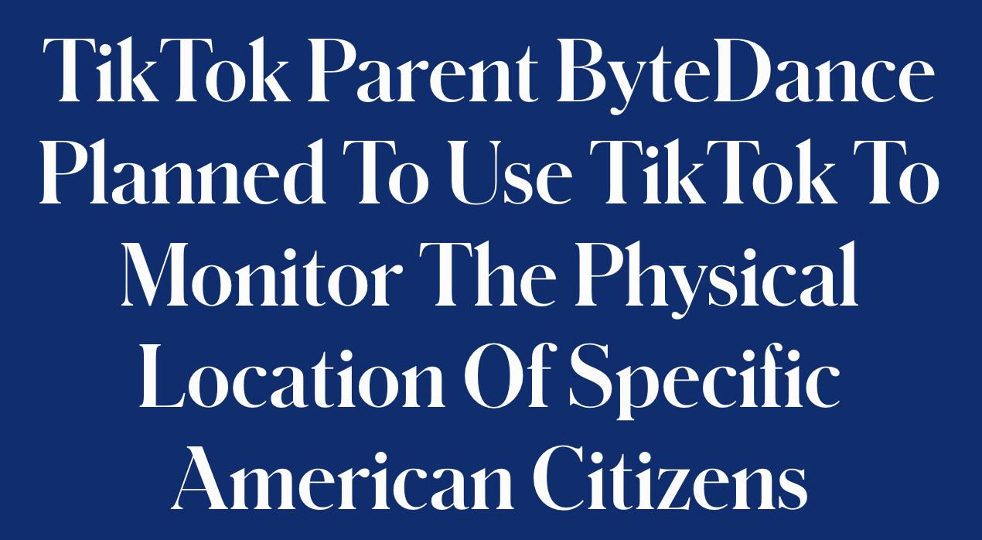

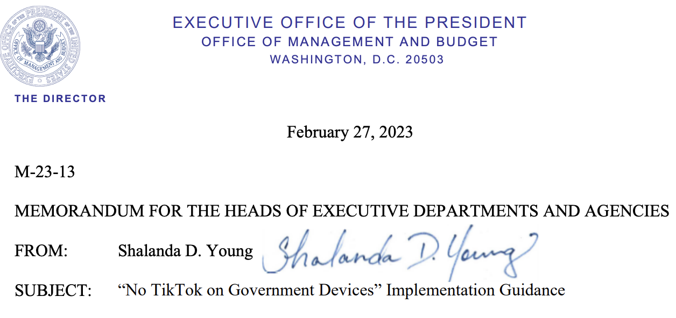
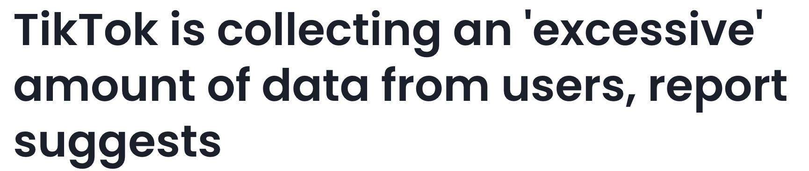
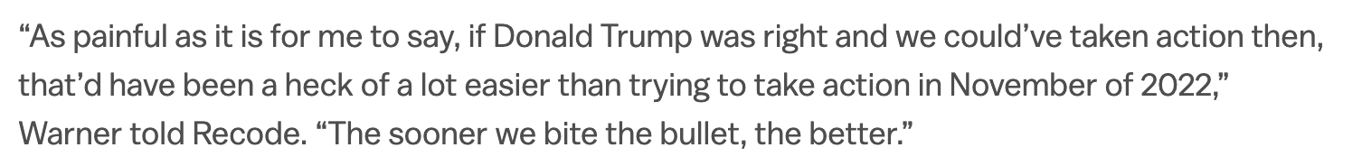

Slide 16
Group Exercise
Reflect in your group on the extent to which confirmation bias was present in reactions to Executive Order 13942 banning TikTok
Consider categorizing reactions along the axes of “fast” and “slow” thinking
Provide examples of potential confirmation bias throughout the controversy

Slide 17
Analysis of Competing Hypotheses (ACH)
Designed to avoid pitfalls of quick, intuitive, judgments with a step-by-step strategy for cultivating methodical, reflective, intelligence gathering
Specifically for guarding against confirmation bias and serial position effects

Slide 18
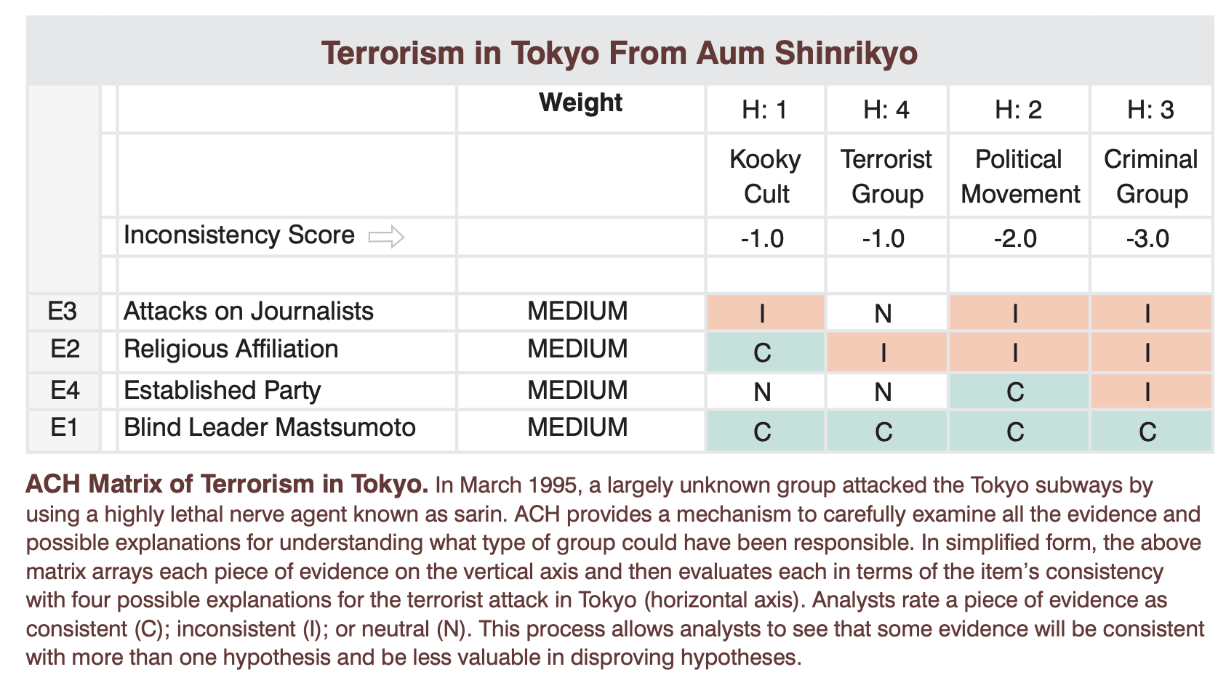
CIA Mitigation Handbook (2009)
ACH has been regularly applied to retrodict and predict the plausibility of evidence for various intelligence matters, just in this way

Slide 19
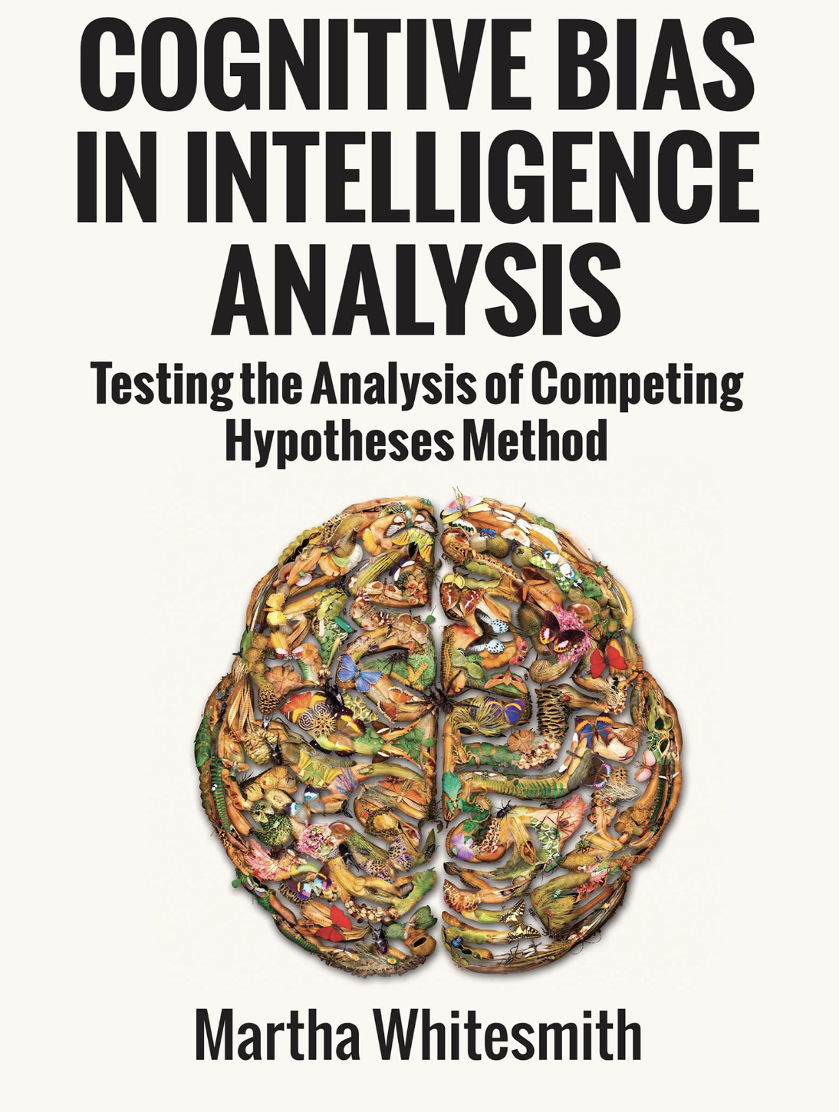
Whitesmith on ACH
ACH had no mitigating impact on confirmation bias or serial position effects.
Confirmation bias and serial position effects stem from analytical conditions that produce a force towards forming a focal hypothesis as early as possible.

Slide 20
Whitesmith on ACH
Impacting serial position effects requires targeting long-term memory.
Impacting confirmation bias requires targeting when the focal hypothesis is formed, i.e. initial stages of information processing as opposed to when all information available has been processed.

Slide 21
Outline
Confirmation Bias and Serial Position Effects
Models of Intelligence Cycle Bias
Caveats for Ontology-Based Strategies

Slide 22
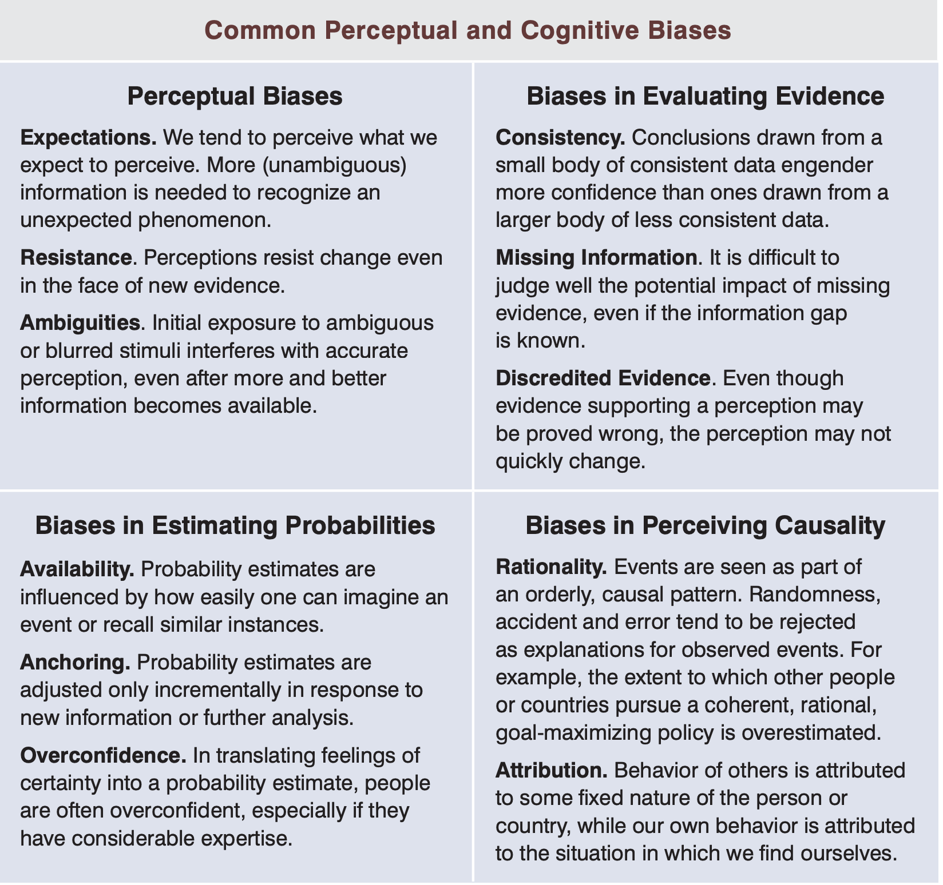
CIA Mitigation Handbook (2009)
ACH is not the only strategy deployed by intelligence agencies to address the risk of bias
Many agencies supplement ACH with a collection of heuristics that are less analytic in their nature and deployment

Slide 23
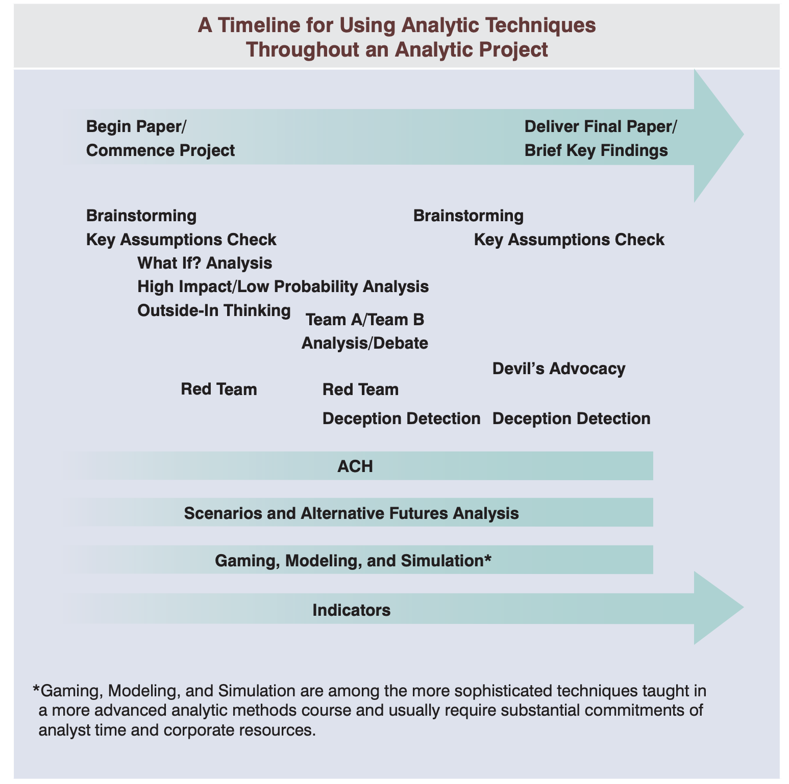
CIA Mitigation Handbook (2009)
ACH is not the only strategy deployed by intelligence agencies to address the risk of bias
Many agencies supplement ACH with a collection of heuristics that are less analytic in their nature and deployment

Slide 24
CIA Mitigation Handbook (2009)
ACH is not the only strategy deployed by intelligence agencies to address the risk of bias
Many agencies supplement ACH with a collection of heuristics that are less analytic in their nature and deployment

Slide 25
CIA Mitigation Handbook (2009)
ACH is not the only strategy deployed by intelligence agencies to address the risk of bias
Many agencies supplement ACH with a collection of heuristics that are less analytic in their nature and deployment

Slide 26
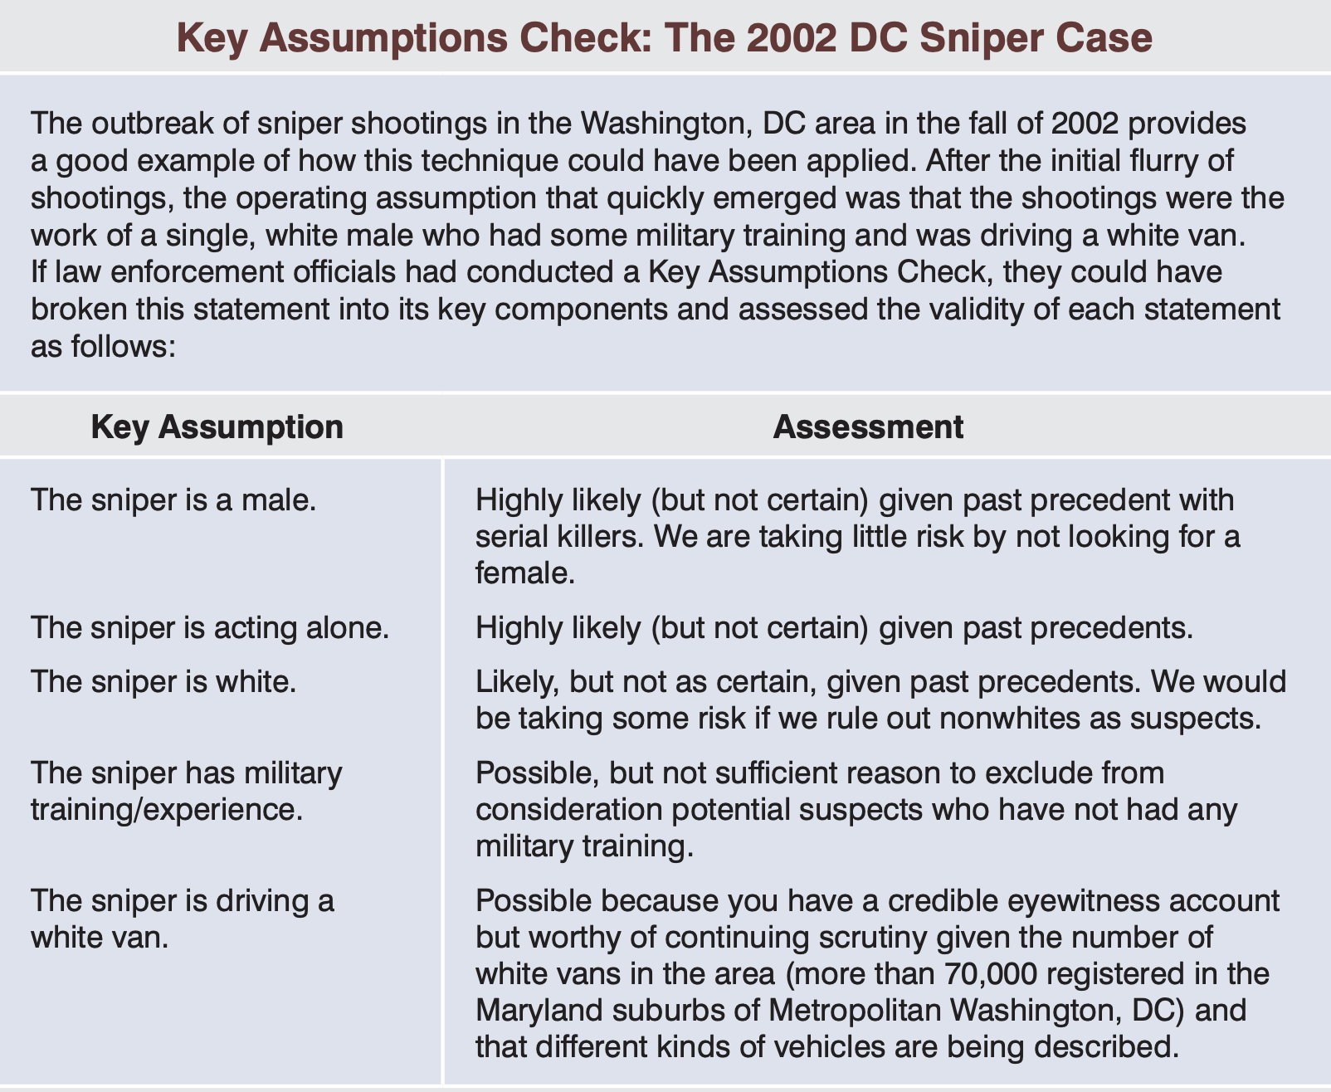
Key Assumptions Check

Slide 27
Group Exercise
Given the key assumptions, speculate on the demographic profile of the sniper.
(If you’re familiar with the case, listen to the group discussion, but participate yourself)

Slide 28
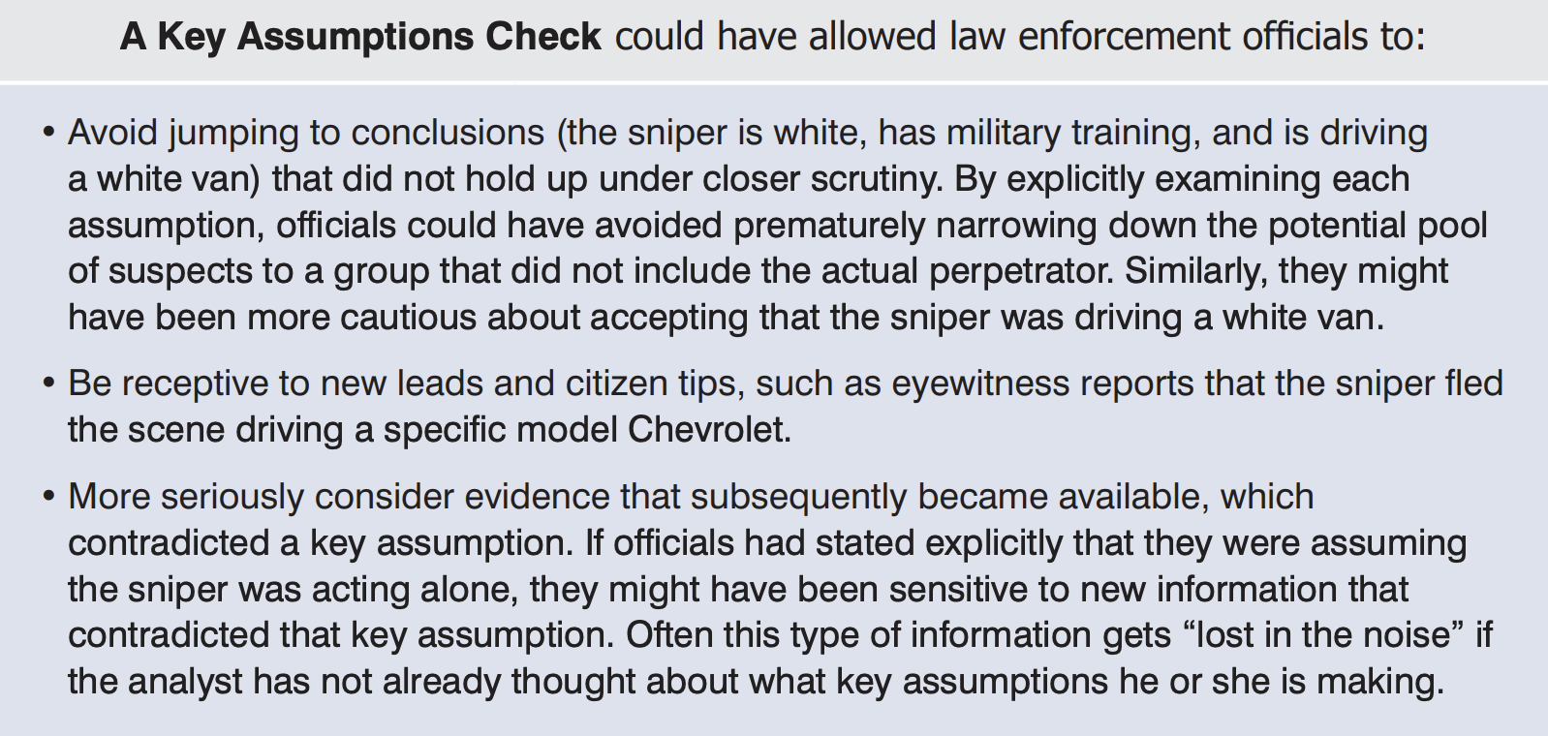
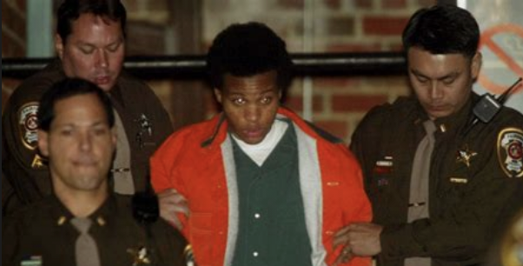
Key Assumptions Check

Slide 29
Whitesmith on Bias Mitigation
The level of detail provided about intelligence source impacts analysts judgement of how its credibility.
Intelligence communities should ensure training incorporates research on:
Epistemic and Normative Defeaters
Reliability and Warrant
Pragmatic Encroachment
ACH is ineffective at preventing confirmation bias, but awareness of the occurrence of cognitive biases is itself an effective mitigation strategy.

Slide 30
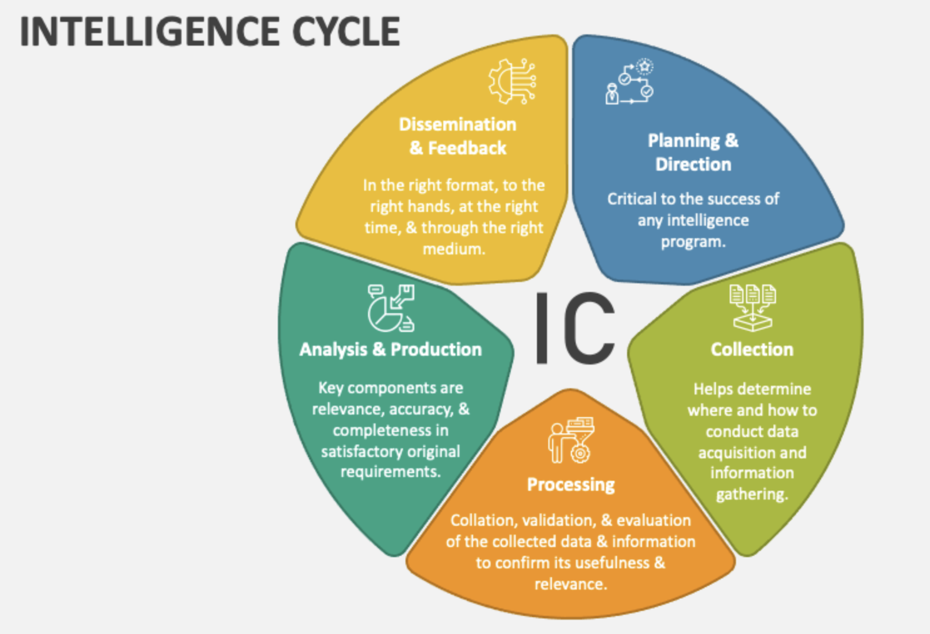

I bring bias to the intelligence cycle
Bias in
the loop

Slide 31
How can I maintain awareness of my own bias?
Bias in
the loop

Slide 32
Model of Cognition
Raw Sensations + Attention
Perception = Concepts + Hierarchies
Cognitive Webs
Behaviors

Slide 33
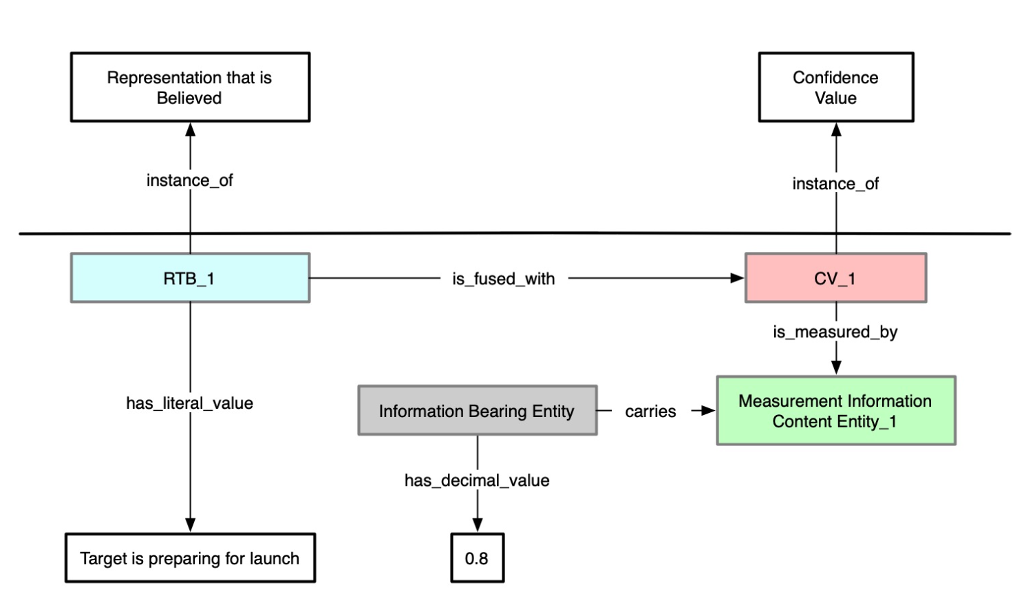
Cognitive Process Ontology
Ontology reflecting aspects of the intelligence cycle

Slide 34
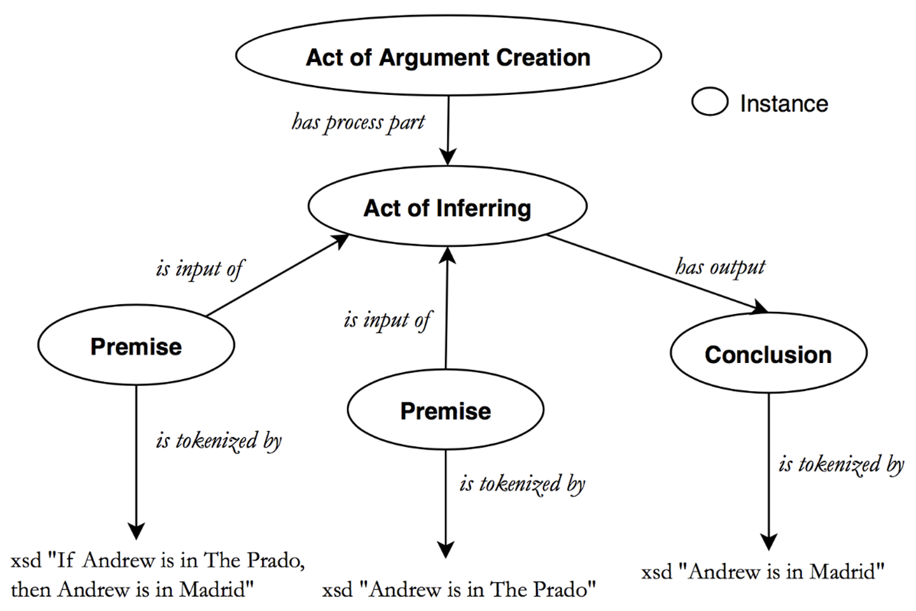
The Arguments Ontology
Ontology reflecting arguments, evidence, and justification

Slide 35
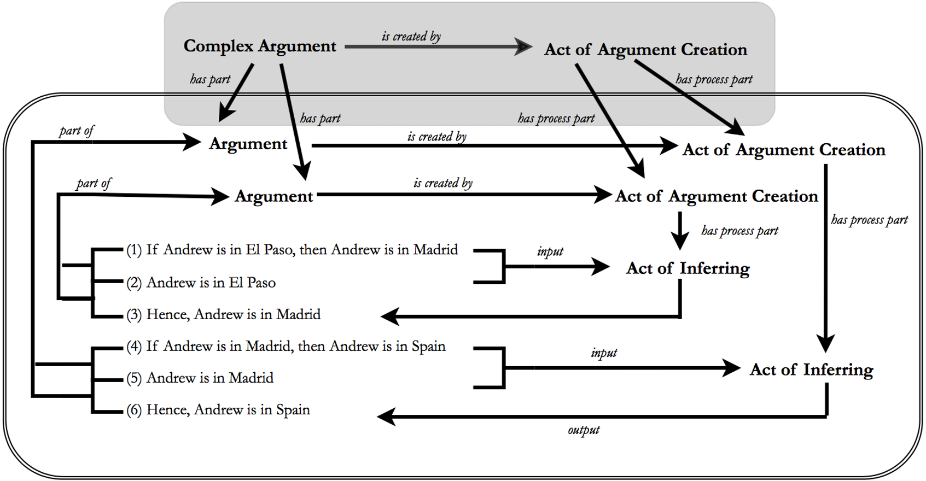
The Arguments Ontology
Ontology reflecting arguments, evidence, and justification

Slide 36
Group Exercise
Gather into small groups and reflect on the definitions presented
In light of your earlier research and the motivations I’ve given here, I would like to you investigate the plausibility of these definitions
Because they are definitions, the left-hand side of the “=_{def}” accurately applies to some phenomena just in case the right-hand side does

Slide 37
Measurement Information Content Entity =_{def} Descriptive Information Content Entity that describes the extent, dimensions, quantity, or quality of an Entity relative to some standard.
Confidence Value =_{def} Mental Quality that, when fused with a Cognitive Representation, determines the extent to which a Cognitive System operates as if Cognitive Representation is veridical.
Representation that is Believed =_{def} Cognitive Representation that is fused with a positive Confidence Value.
Act of Argument Creation =_{def} A language act in which an agent creates an argument by combining one or more statements to support a conclusion.
Act of Inferring =_{def} A language act in which an agent uses one or more statements to support, justify, entail, or assert the truth of another statement.
Act of Accepting =_{def} A language act in which a statement is stated implicitly or explicitly in a forceful or confident manner, which conveys to others that the agent of the language act believes or has confidence in the truth or accuracy of the statement. DECEPTION OLIVIA!

Slide 38
Varieties of Failure
ATTENTION BLINDNESS
ILLUSIONS
Raw Sensations + Attention
Perception = Concepts + Hierarchies
Cognitive Webs
Behaviors
AVAILABILITY BIAS
ANCHOR BIAS
PRIMING EFFECTS
EPISTEMIC INERTIA
MOTIVATED REASONING
VALUE IGNORANCE
BAD HABITS

Slide 39
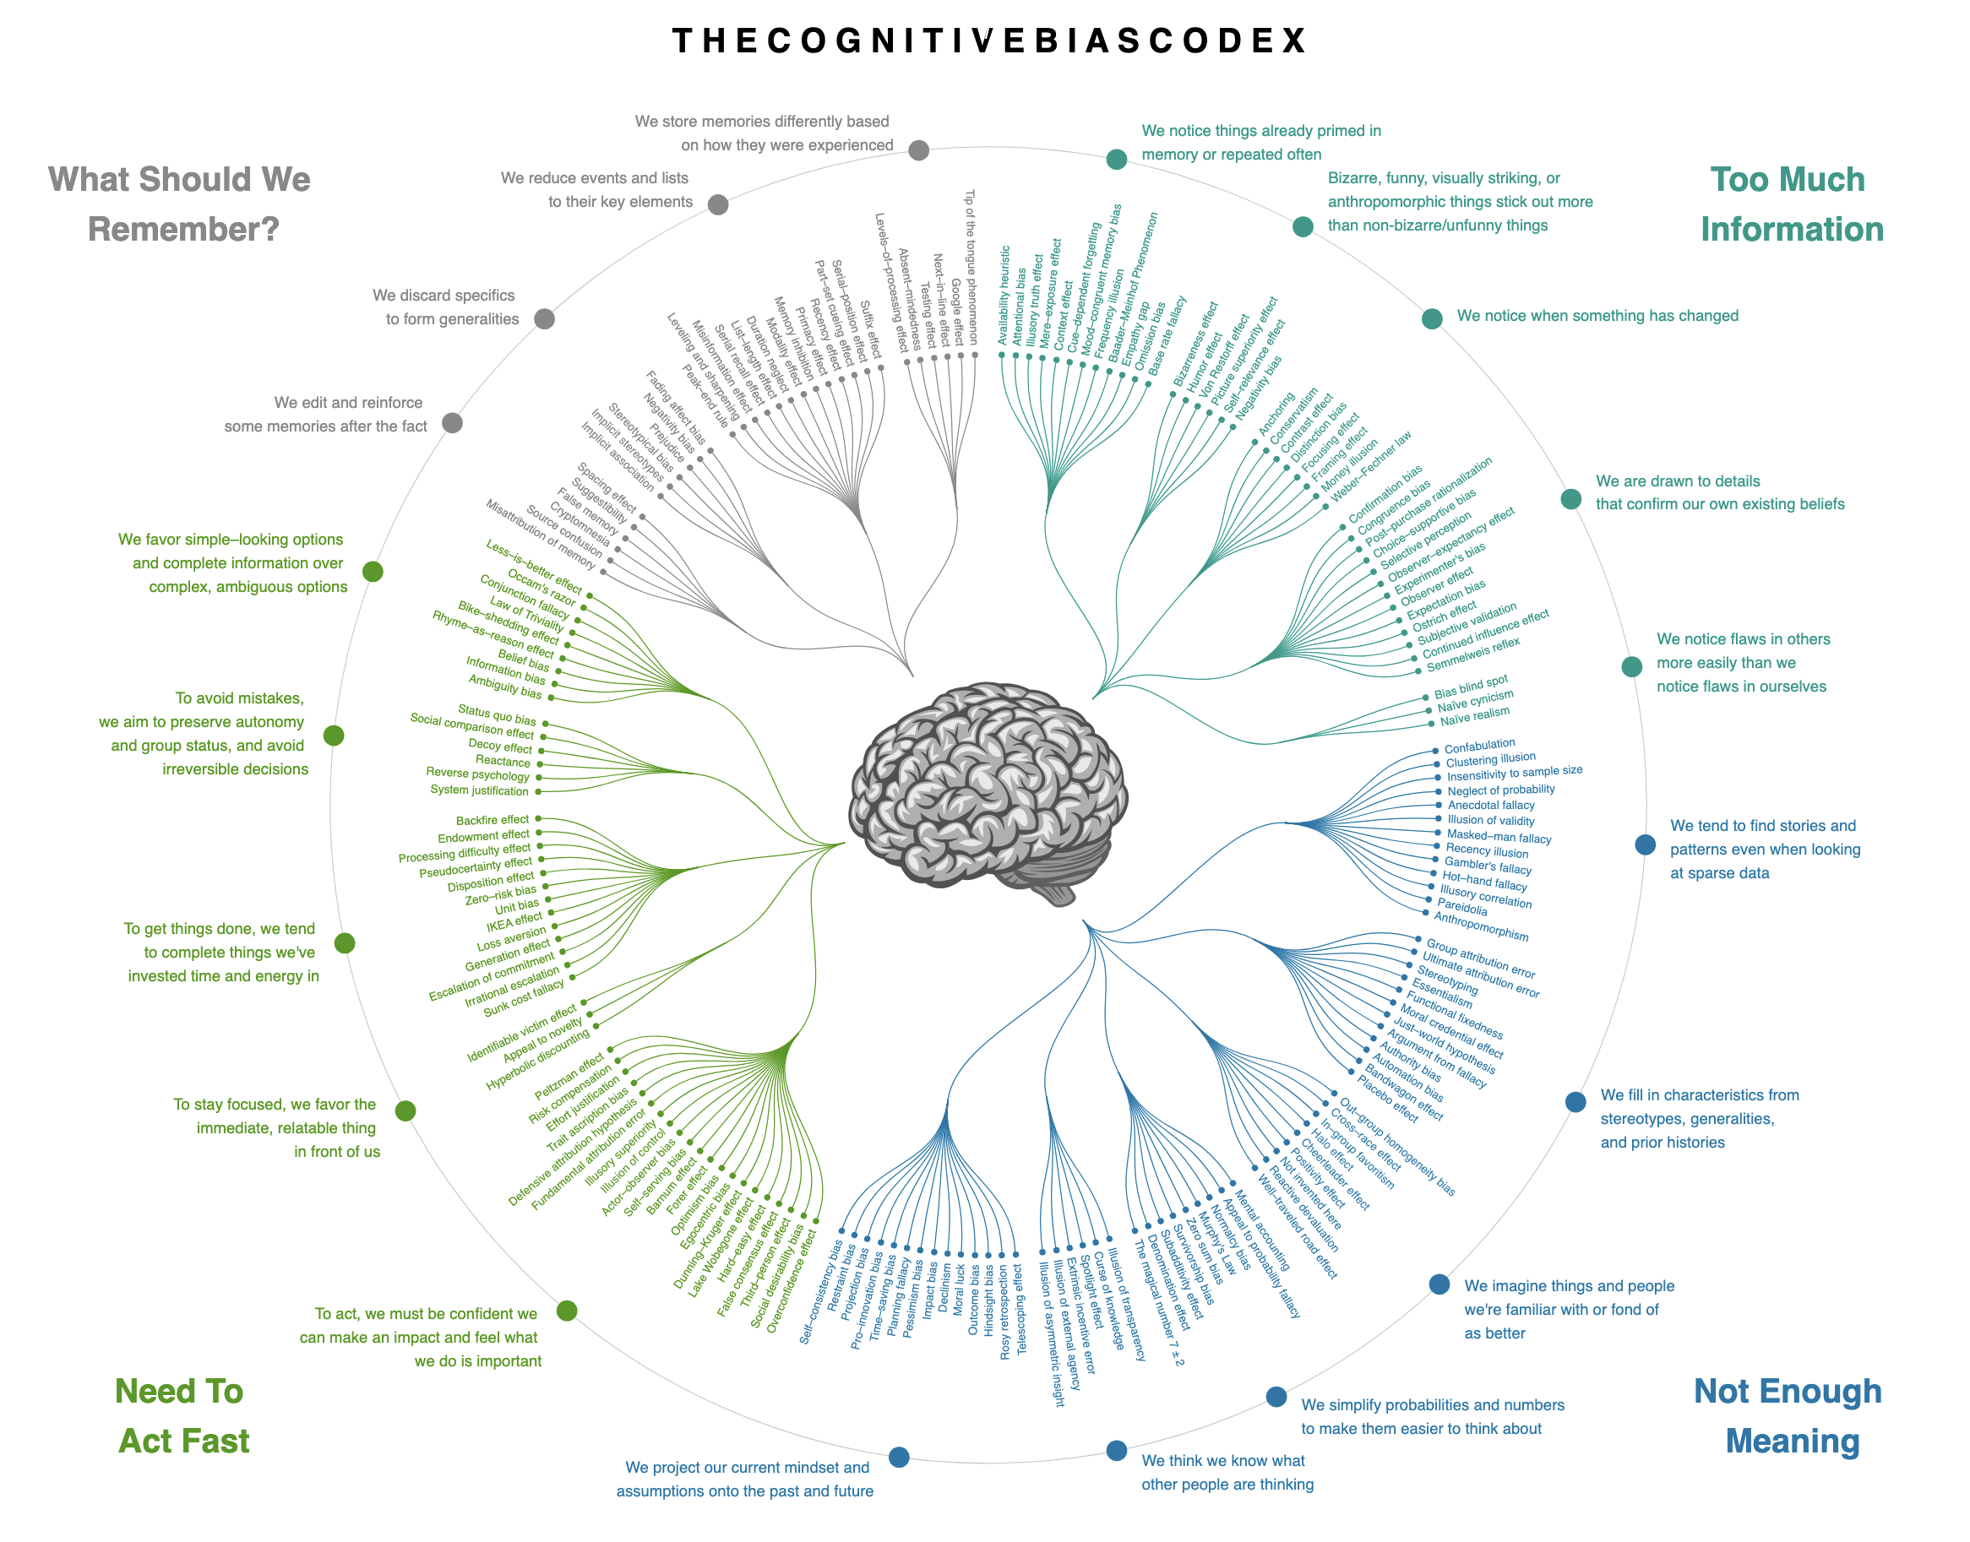
Cognitive Bias Codex (Wikipedia)

Slide 40
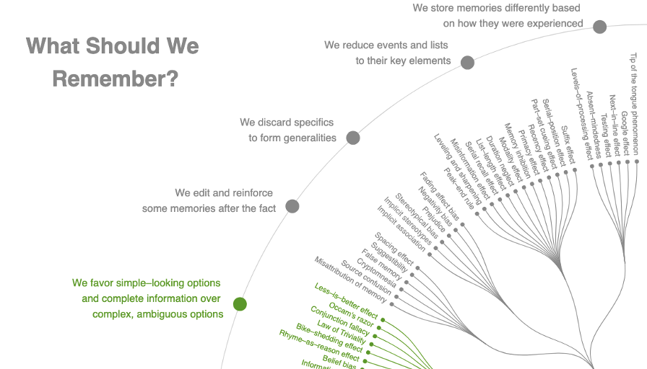
Cognitive Bias Codex (Wikipedia)

Slide 41
Group Exercise
Gather into small groups and attempt to construct a definition of “bias” and/or nearby and related terms
Be sure to construct your definition(s) using the “A is a B that Cs” pattern
B is the parent class under which A falls; C is the differentia that distinguishes A from all the sibling subclasses of B

Slide 42
Summary of Descriptions/Challenges
DESCRIPTIONS
System 1 & System 2
Emotions & Rationality
Model of Cognition
Syntax & Semantics
Pattern Recognizers
CHALLENGES
Attention
Memory
Stress
Cognitive Bias
Statistical Bias

Slide 43
Summary of Descriptions/Challenges
DESCRIPTIONS
System 1 & System 2
Emotions & Rationality
Model of Cognition
Syntax & Semantics
Pattern Recognizers
CHALLENGES
Attention
Memory
Stress
Cognitive Bias
Statistical Bias
FAST AND SLOW THINKING

Slide 44
Summary of Descriptions/Challenges
DESCRIPTIONS
System 1 & System 2
Emotions & Rationality
Model of Cognition
Syntax & Semantics
Pattern Recognizers
CHALLENGES
Attention
Memory
Stress
Cognitive Bias
Statistical Bias
VALENCE NEEDED TO CALCULATE

Slide 45
Summary of Descriptions/Challenges
DESCRIPTIONS
System 1 & System 2
Emotions & Rationality
Model of Cognition
Syntax & Semantics
Pattern Recognizers
CHALLENGES
Attention
Memory
Stress
Cognitive Bias
Statistical Bias
INPUT, HIERARCHY, WEB

Slide 46
Summary of Descriptions/Challenges
DESCRIPTIONS
System 1 & System 2
Emotions & Rationality
Model of Cognition
Syntax & Semantics
Pattern Recognizers
CHALLENGES
Attention
Memory
Stress
Cognitive Bias
Statistical Bias
ABSTRACTION & REFERENCE

Slide 47
Summary of Descriptions/Challenges
DESCRIPTIONS
System 1 & System 2
Emotions & Rationality
Model of Cognition
Syntax & Semantics
Pattern Recognizers
CHALLENGES
Attention
Memory
Stress
Cognitive Bias
Statistical Bias
FIRE IS HOT, RIGHT?! RIGHT.

Slide 48
Summary of Descriptions/Challenges
DESCRIPTIONS
System 1 & System 2
Emotions & Rationality
Model of Cognition
Syntax & Semantics
Pattern Recognizers
CHALLENGES
Attention
Memory
Stress
Cognitive Bias
Statistical Bias
CAN ONLY ATTEND TO SO MUCH

Slide 49
Summary of Descriptions/Challenges
DESCRIPTIONS
System 1 & System 2
Emotions & Rationality
Model of Cognition
Syntax & Semantics
Pattern Recognizers
CHALLENGES
Attention
Memory
Stress
Cognitive Bias
Statistical Bias
SHORT, LONG, EPISODIC, 7+-

Slide 50
Chunking
We’re able to remember without much difficulty about 7 random items, plus or minus 2
Try to remember this string of numbers:
314159265358978

Slide 51
Chunking
We’re able to remember without much difficulty about 7 random items, plus or minus 2
Try to remember this string of numbers:
CAN YOU RECITE THE STRING?

Slide 52
Chunking
We’re able to remember without much difficulty about 7 random items, plus or minus 2
Try to remember this string of numbers:
246 9878 9923 765

Slide 53
Chunking
We’re able to remember without much difficulty about 7 random items, plus or minus 2
Try to remember this string of numbers:
CAN YOU RECITE THE STRING?

Slide 54
Chunking
Try to remember this string of numbers:
246 9878 9923 765
These groupings become the new ‘items’ to remember
Examples:
Phone Number – 1-234-567-8901
Social Security Number – 123-45-6789

Slide 55
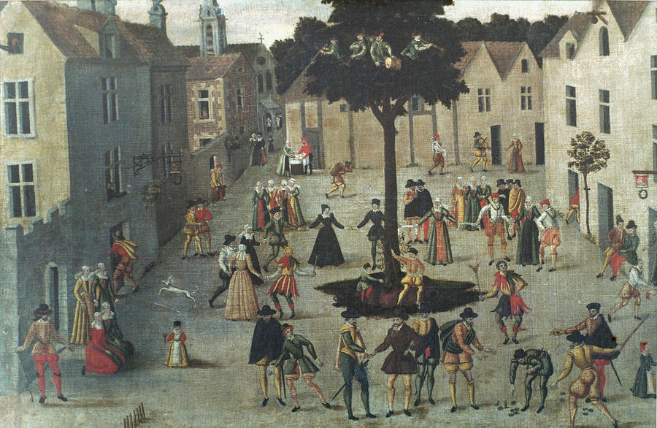
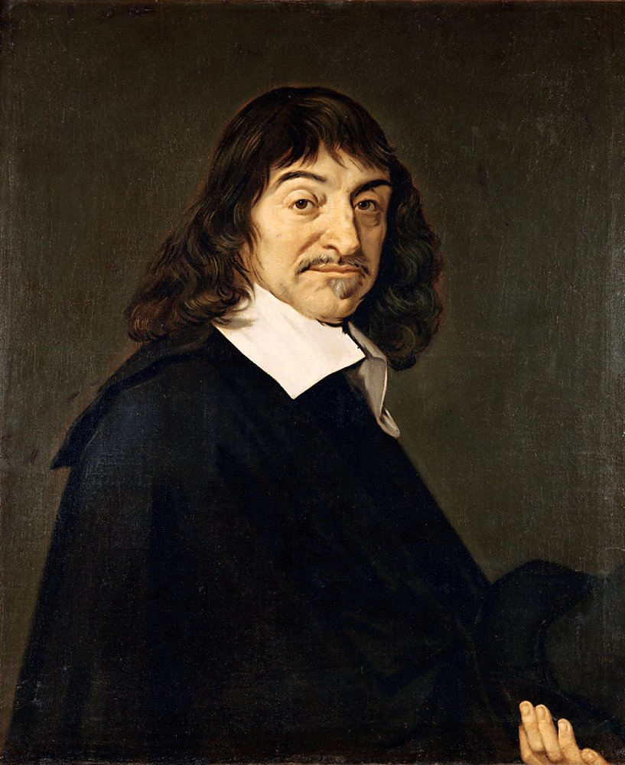
French Townies
Descartes

Slide 56

Sacre bleu!

Slide 57
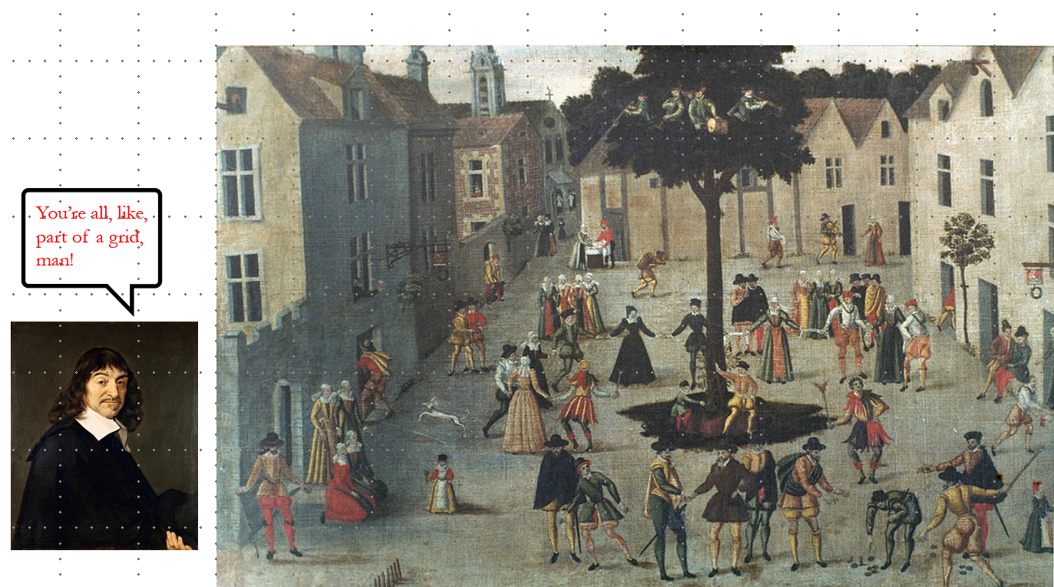

Slide 58
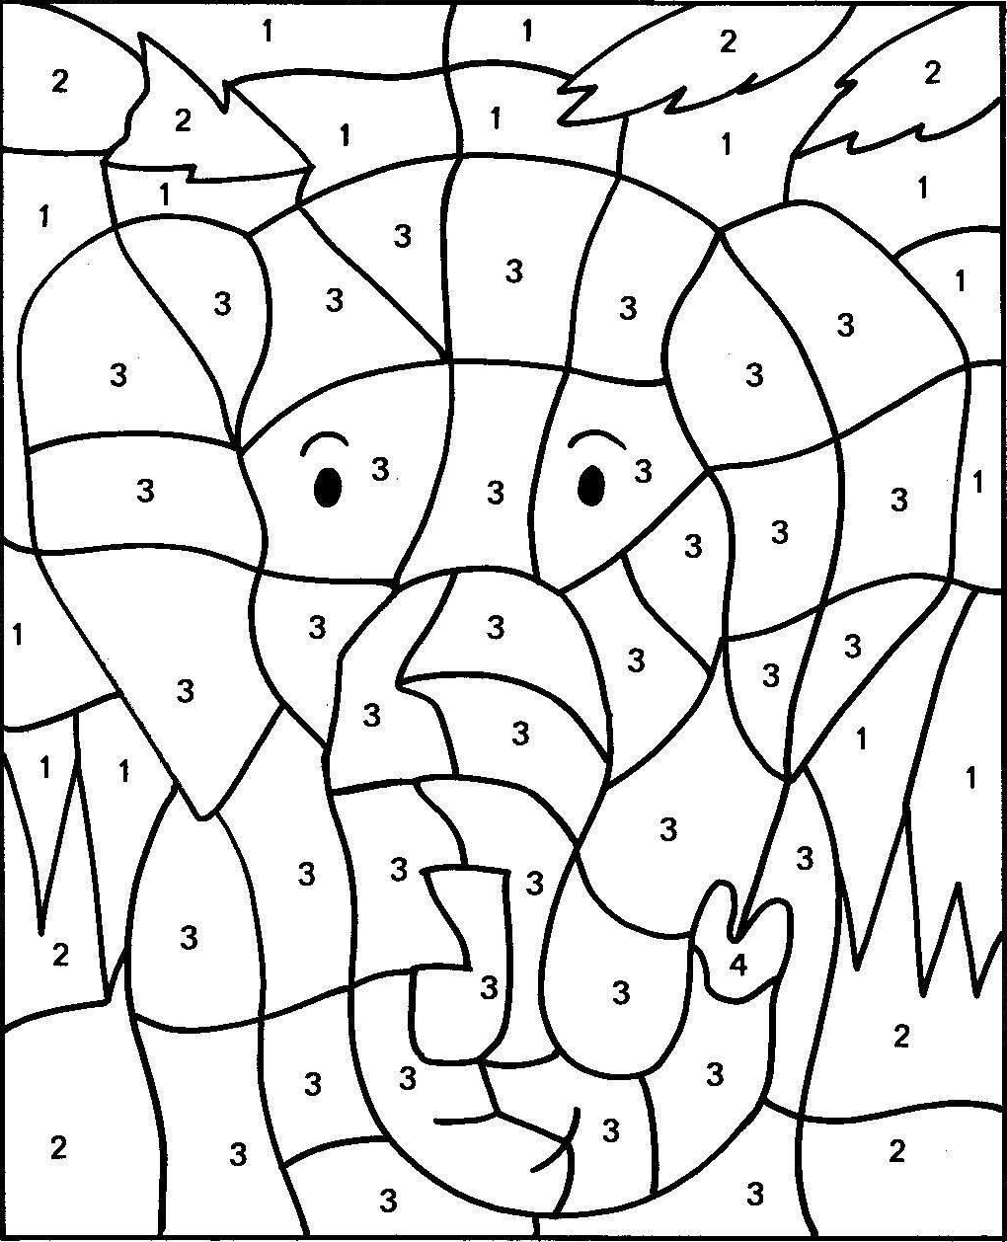
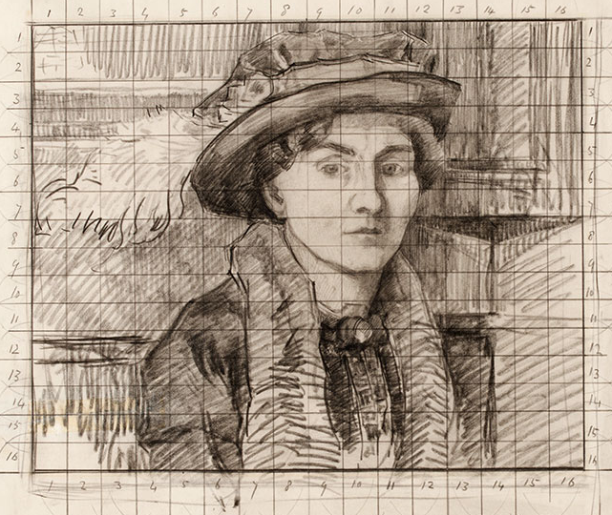
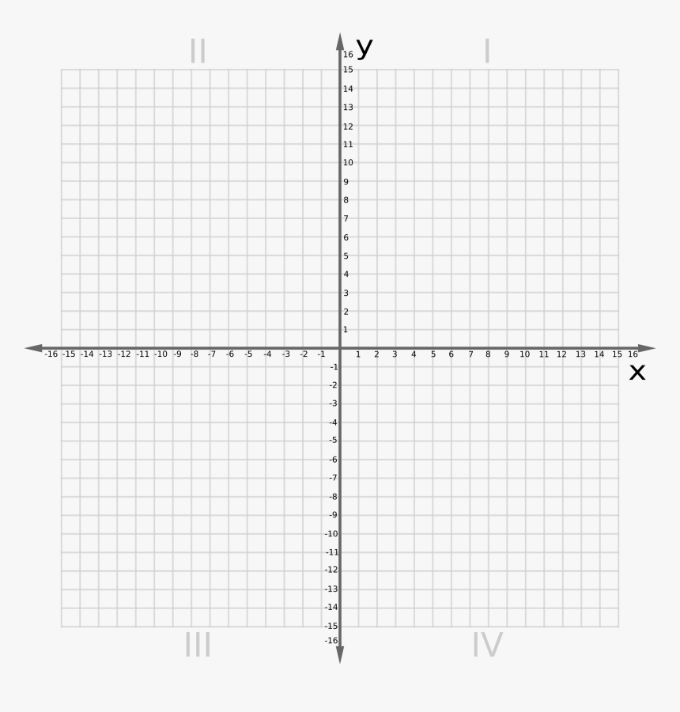
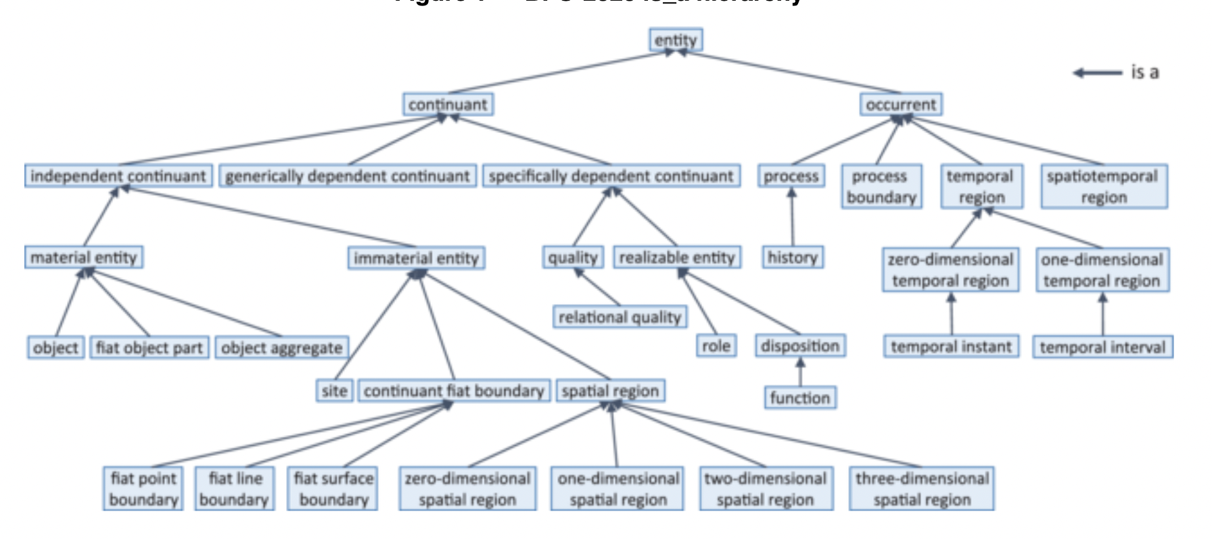
Divide & Conquer
A divide-and-conquer heuristic allows us to break down complex information into digestible parts
Paint by Numbers
Ontology Engineering
Grid Method
Cartesian Plane

Slide 59
Summary of Descriptions/Challenges
DESCRIPTIONS
System 1 & System 2
Emotions & Rationality
Model of Cognition
Syntax & Semantics
Pattern Recognizers
CHALLENGES
Attention
Memory
Stress
Cognitive Bias
Statistical Bias
UNDERMINES ATTENTION/ENCODING

Slide 60
Summary of Descriptions/Challenges
DESCRIPTIONS
System 1 & System 2
Emotions & Rationality
Model of Cognition
Syntax & Semantics
Pattern Recognizers
CHALLENGES
Attention
Memory
Stress
Cognitive Bias
Statistical Bias
ANCHOR, AVAILABILITY, PRIMING

Slide 61
Summary of Descriptions/Challenges
DESCRIPTIONS
System 1 & System 2
Emotions & Rationality
Model of Cognition
Syntax & Semantics
Pattern Recognizers
CHALLENGES
Attention
Memory
Stress
Cognitive Bias
Statistical Bias

Slide 62
Group Exercise
Linda is 31 years old, single, outspoken, and bright. She majored in philosophy. As a student, she was deeply concerned with issues of discrimination and social justice, and participated in anti-nuclear protests.
Which is more probable?
Linda is a bank teller
Linda is a bank teller and is active in the feminist movement

Slide 63
Probability
Consider all the possible ways in which it could be true that Linda is a bank teller
Linda is a bank teller

Slide 64

Probability
Consider all the possible ways in which it could be true that Linda is a bank teller
Compared to all the possible ways in which it could be true that Linda is a bank teller and an active feminist
Linda is a bank teller
Linda is an active feminist

Slide 65
Independence
This works if we assume these possibilities are independent
A is independent of B just in case the intersection of the number of ways in which A and B might occur is the same as the number of ways in which A might occur and number of ways in which B might occur
A
B

Slide 66
Independence Illustration
In a hospital in which 6 male or female assigned babies are born, one after the other over a week, which of the following sequences is more probable
B B B B F F
B F B B F B

Slide 67
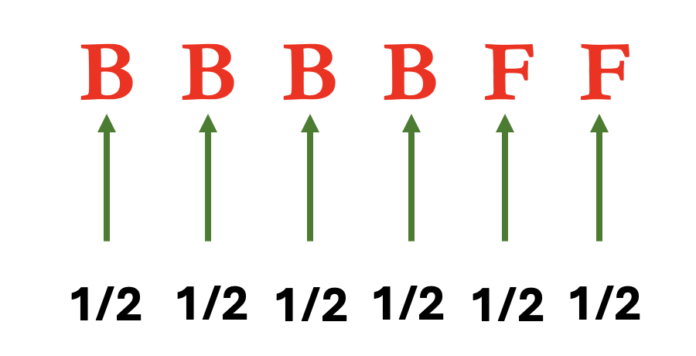


Independence Illustration
In a hospital in which 6 male or female assigned babies are born, one after the other over a week, which of the following sequences is more probable
NEITHER

Slide 68
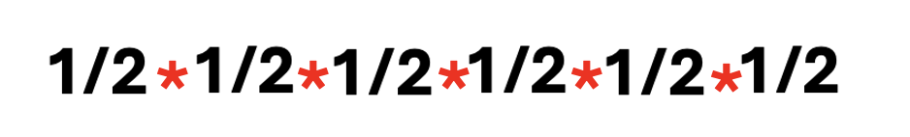
Independence Illustration
In a hospital in which 6 male or female assigned babies are born, one after the other over a week, which of the following sequences is more probable
NEITHER
=
.0156
=

Slide 69
Summary of Descriptions/Challenges
DESCRIPTIONS
System 1 & System 2
Emotions & Rationality
Model of Cognition
Syntax & Semantics
Pattern Recognizers
CHALLENGES
Attention
Memory
Stress
Cognitive Bias
Statistical Bias

Slide 70
Group Exercise
Suppose you’ve just been tested for COVID-19, i.e. SARS-CoV-2 infection, and it’s positive
The test has a 95% accuracy rate, i.e. 95% of those infected are classified as positive, and 95% of those not infected will have a negative result
The assumed prevalence of infection in the population is 1/125
What’s the probability that you have been infected by SARS-CoV-2?

Slide 71
Group Exercise
Suppose you’ve just been tested for COVID-19, i.e. SARS-CoV-2 infection, and it’s positive
The test has a 95% accuracy rate, i.e. 95% of those infected are classified as positive, and 95% of those not infected will have a negative result
The assumed prevalence of infection in the population is 1/125
~13%

Slide 72
Base Rate Fallacy
We tend to conflate:
The proportion of actual positive cases classified as positive
The proportion of cases classified as positive that are actually positive
But if our test is very accurate (95%) while disease prevalence is low (1/125)…
We may have a large number of false positives

Slide 73
Base Rate Fallacy
328,000,000
U.S. Population

Slide 74
Base Rate Fallacy
Infected
328,000,000
Not Infected
U.S. Population
2,624,000
325,376,000
Infection Prevalence
1/125

Slide 75
Base Rate Fallacy
Infected
328,000,000
Not Infected
U.S. Population
2,624,000
325,376,000
95% Accuracy
2,492,800
131,200
Test Positive
Test Negative

Slide 76
Base Rate Fallacy
Infected
328,000,000
Not Infected
U.S. Population
2,624,000
325,376,000
True Positives
False Negatives
2,492,800
131,200
Test Positive
Test Negative

Slide 77
Base Rate Fallacy
Infected
328,000,000
Not Infected
U.S. Population
2,624,000
325,376,000
95% Accuracy
2,492,800
131,200
309,107,200
16,268,800
Test Positive
Test Negative
Test Negative
Test Positive

Slide 78
Base Rate Fallacy
Infected
328,000,000
Not Infected
U.S. Population
2,624,000
325,376,000
True Negatives
False Positives
2,492,800
131,200
309,107,200
16,268,800
Test Positive
Test Negative
Test Negative
Test Positive

Slide 79
Base Rate Fallacy
Infected
328,000,000
Not Infected
U.S. Population
2,624,000
325,376,000
18,761,600
Total Positive
2,492,800
131,200
309,107,200
16,268,800
Test Positive
Test Negative
Test Negative
Test Positive

Slide 80
Base Rate Fallacy
Infected
328,000,000
Not Infected
U.S. Population
2,624,000
325,376,000
2,492,800
18,761,600
Real/Total Positive
2,492,800
131,200
309,107,200
16,268,800
Test Positive
Test Negative
Test Negative
Test Positive

Slide 81
Base Rate Fallacy
Infected
328,000,000
Not Infected
U.S. Population
2,624,000
325,376,000
= .13
2,492,800
131,200
309,107,200
16,268,800
Test Positive
Test Negative
Test Negative
Test Positive

Slide 82
Base Rate Fallacy
The proportion of actual positive cases classified as positive
2,492,800/(2,492,800 + 16,268,800) = .13
The proportion of cases classified as positive that are actually positive
2,492,800/2,624,000 = .95

Slide 83
Summary of Descriptions/Challenges
DESCRIPTIONS
System 1 & System 2
Emotions & Rationality
Model of Cognition
Syntax & Semantics
Pattern Recognizers
CHALLENGES
Attention
Memory
Stress
Cognitive Bias
Statistical Bias
INDEPENDENCE, BASE RATE FALLACY

Slide 84
Group Exercise
DESCRIPTIONS
System 1 & System 2
Emotions & Rationality
Model of Cognition
Syntax & Semantics
Pattern Recognizers
CHALLENGES
Attention
Memory
Stress
Cognitive Bias
Statistical Bias
DEFINE THESE TERMS ONTOLOGICALLY

Slide 85




Guidance

Slide 86
Outline
Confirmation Bias and Serial Position Effects
Models of Intelligence Cycle Bias
Caveats for Ontology-Based Strategies

Slide 87
Ontologies in the Intelligence Cycle
“Across all phases, but especially in the Planning & Direction and the Dissemination, it is crucial to maintain an established” standardized ontology
Should be used in all information circulating within the agency, and among collaborating agencies.
Karakikes, et. al. (2023) are correct that a unified standard ontology is needed to promote planning, direction, and dissemination

Slide 88
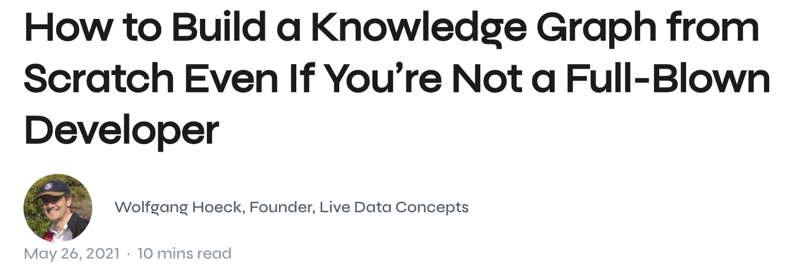
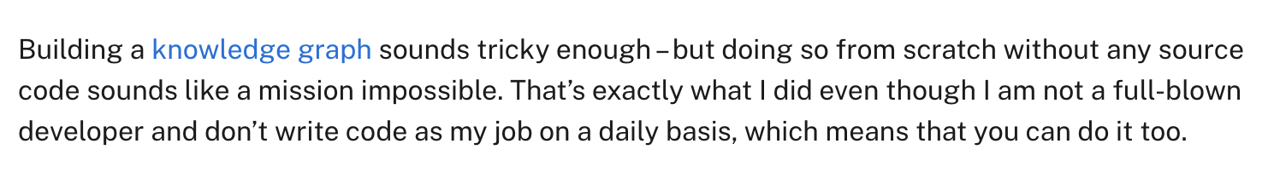

Slide 89

just another data silo

Slide 90
Making Knowledge Graph is Easy!
Constructing a knowledge graph is actually quite easy...
It is straightforward to write a simple python script to read csv files and churn out classes and relations based on column headers
Constructing a knowledge graph according to a standard is quite a bit more challenging
But modeling according to a standard is how we avoid silos

Slide 91
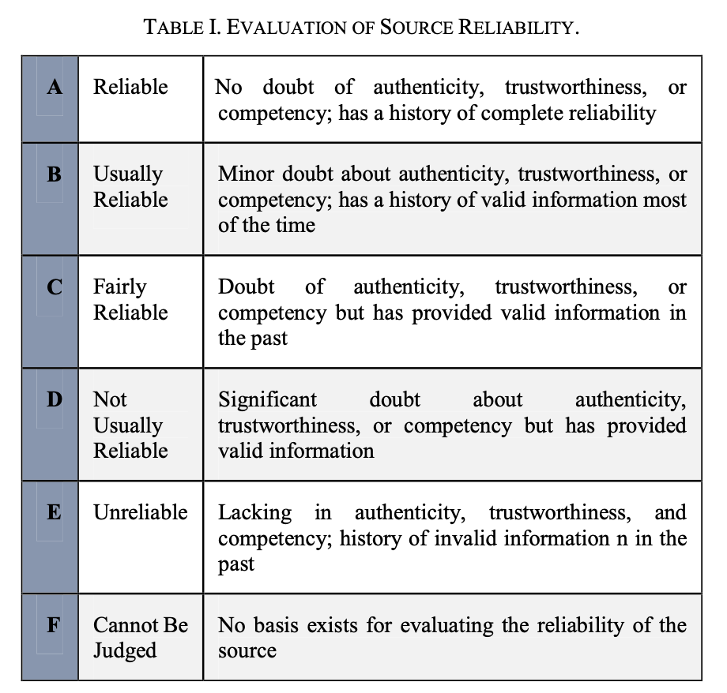
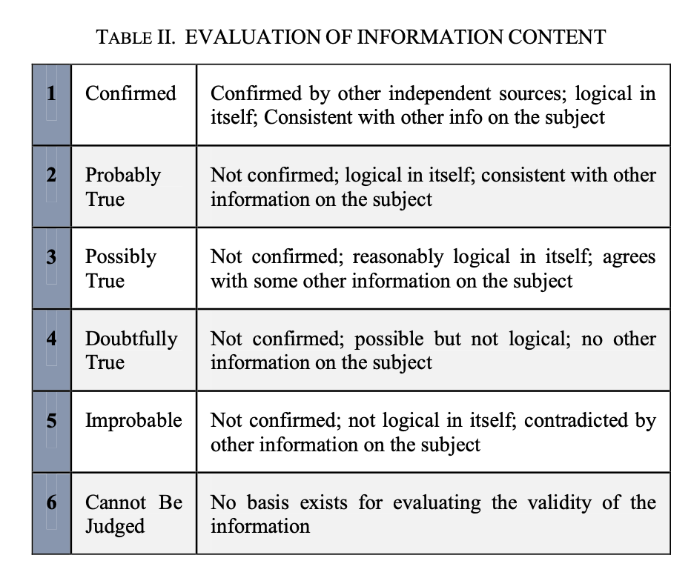
Caveat: Benchmarks May Promote Silos

Slide 92
Caveat: Benchmarks May Promote Silos

Slide 93
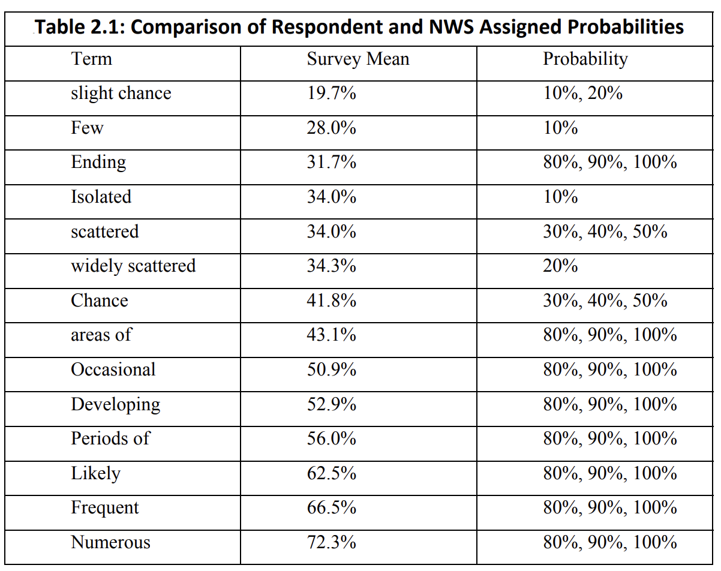
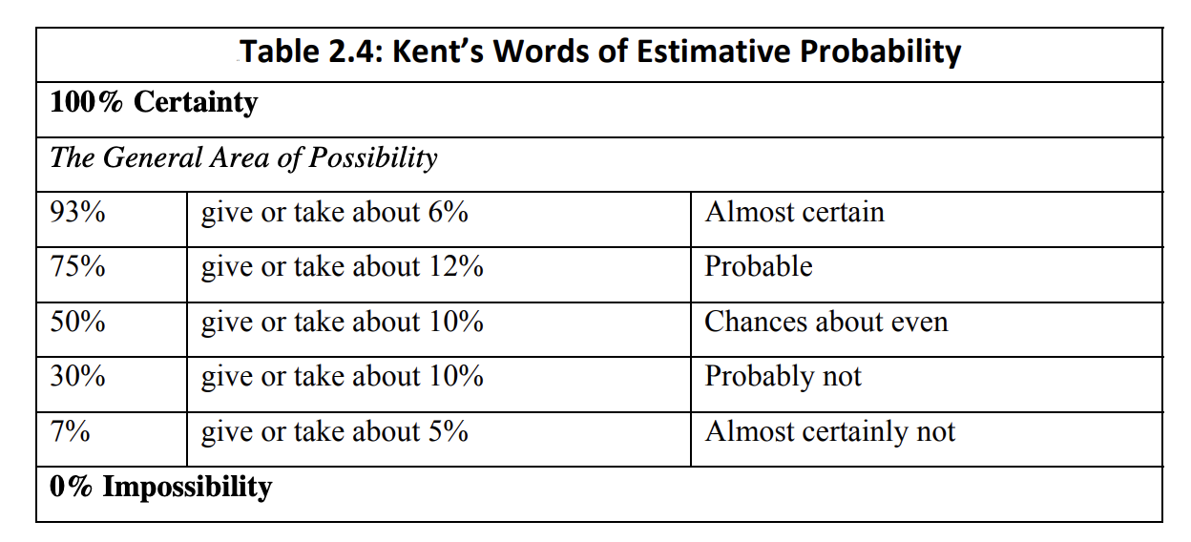
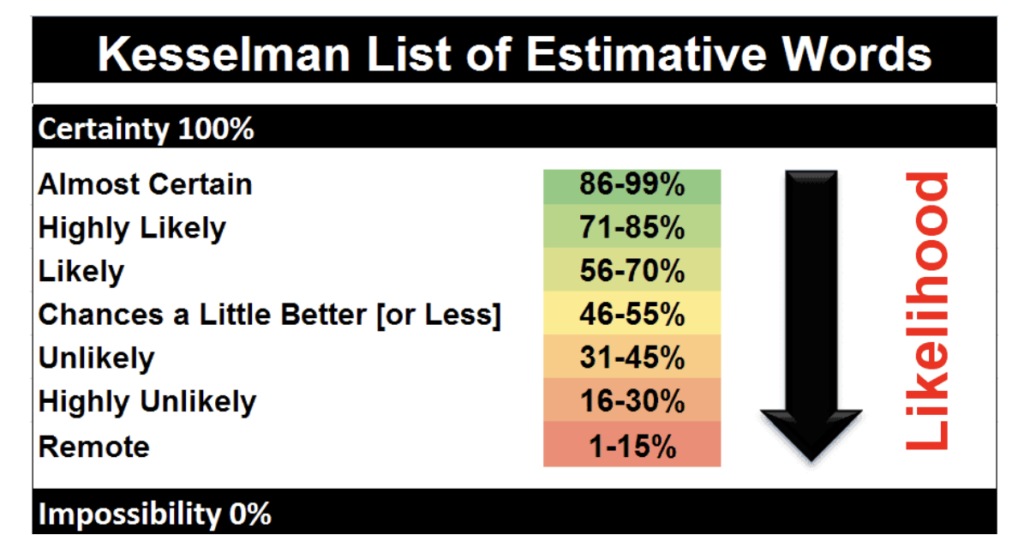
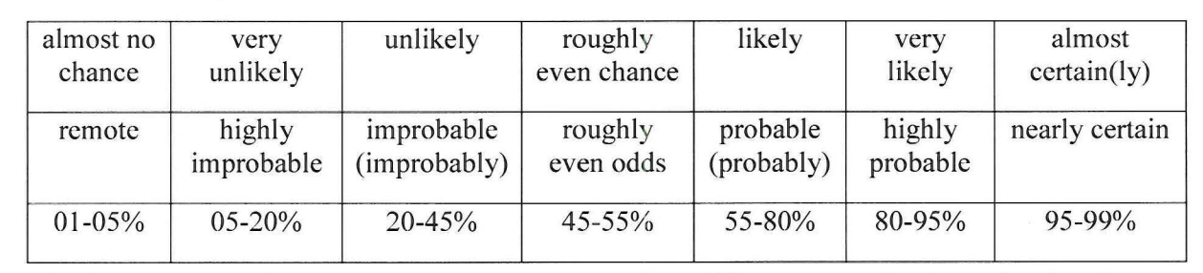
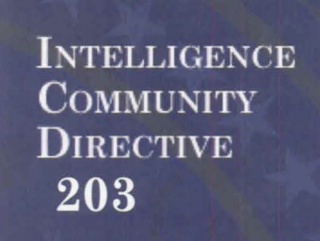
SILOS

Slide 94
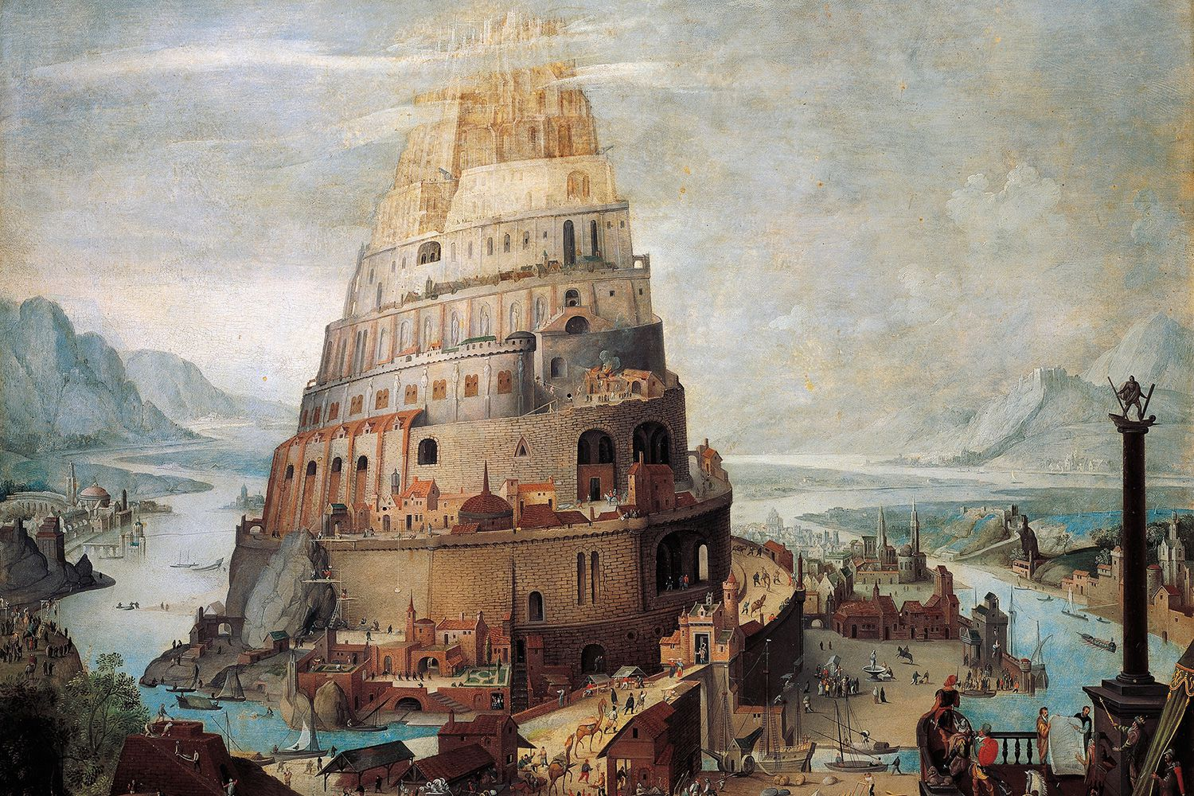
Caveat: Standards May Perpetuate Bias
However, ontologies may perpetuate instead of mitigate bias.
Status Quo – Disposition to maintain current beliefs rather than consider alternatives, to avoid loss
Anchoring – Disposition to consider the plausibility of alternative explanations nearby to those initially presented
Confirmation - Disposition to seek information that supports, rather than rejects, existing beliefs.
Karakikes, et. al. (2023) do not sufficiently engage with this issue

Slide 95
Readings
Whitesmith, Part 2
Towards Handling Bias in Intelligence Analysis with Twitter

